Slide 1
PC 11
Trigonometry Review

Slide 2
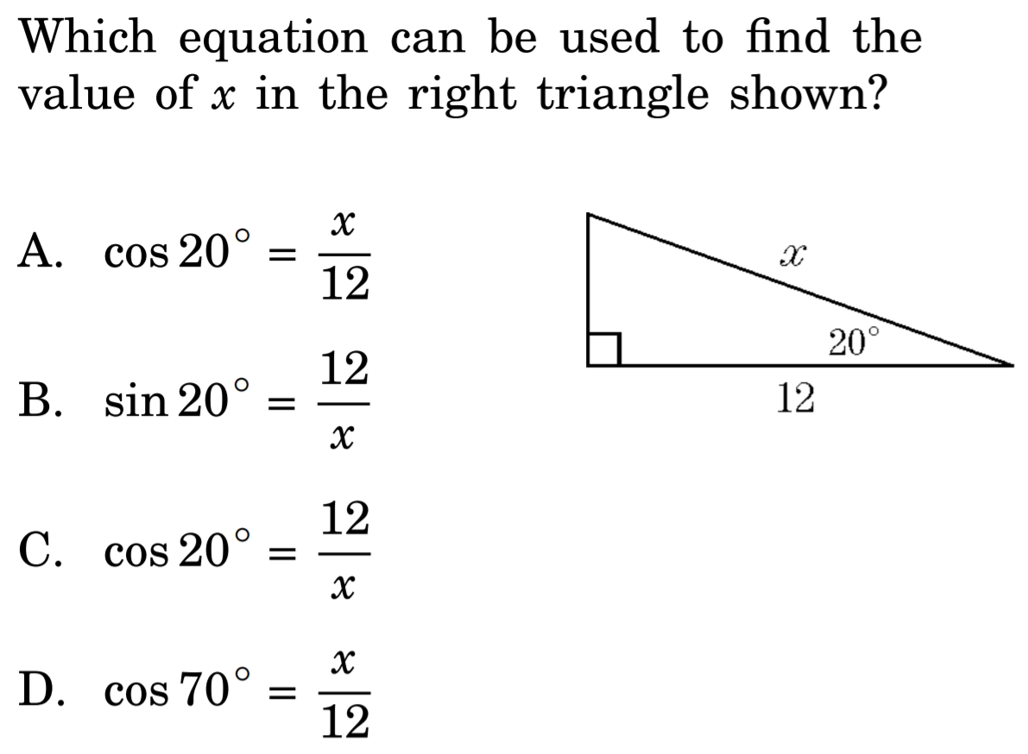

Slide 3
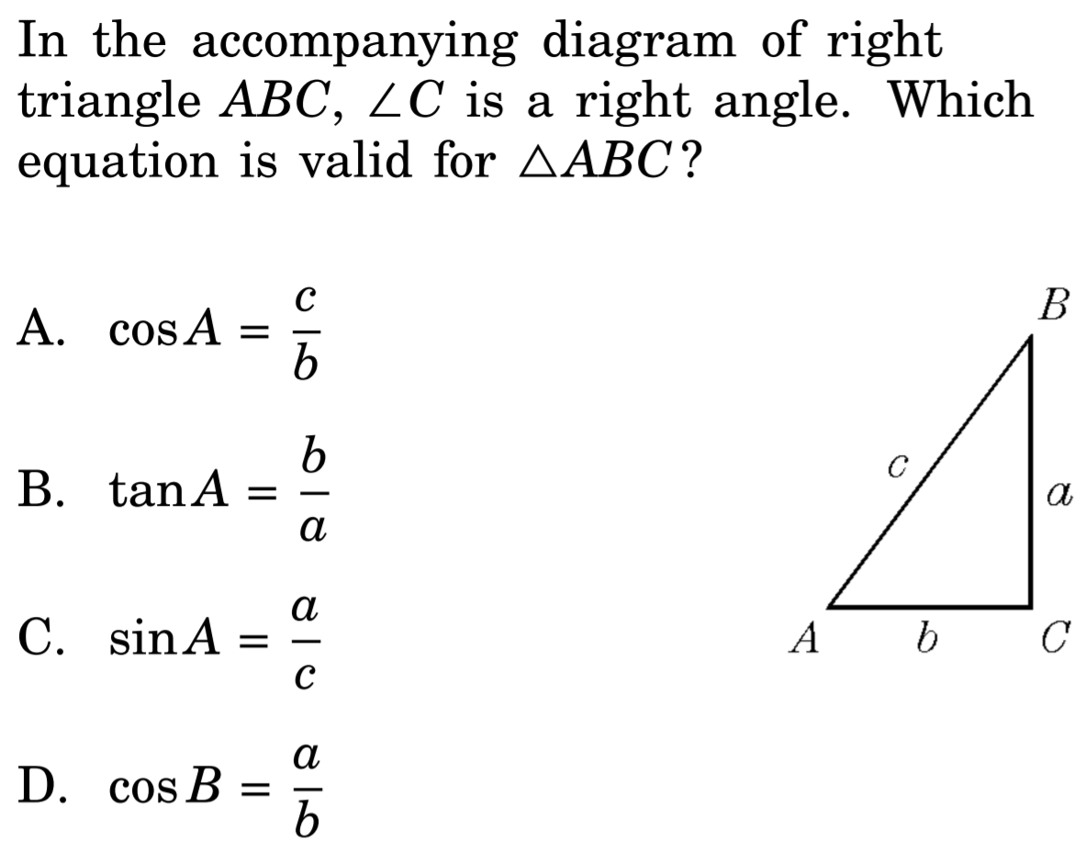

Slide 4
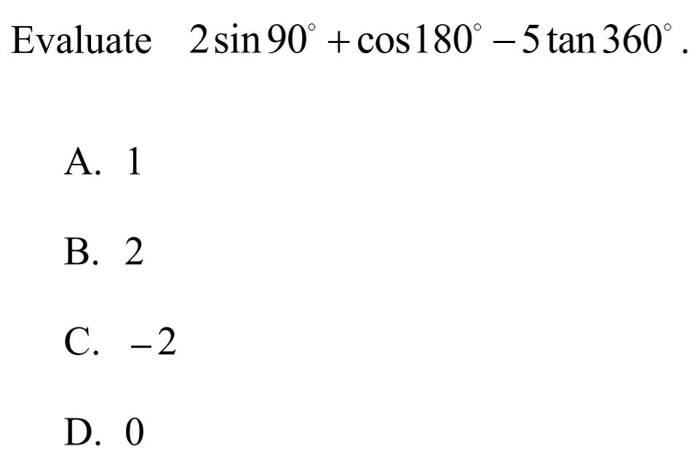

Slide 5
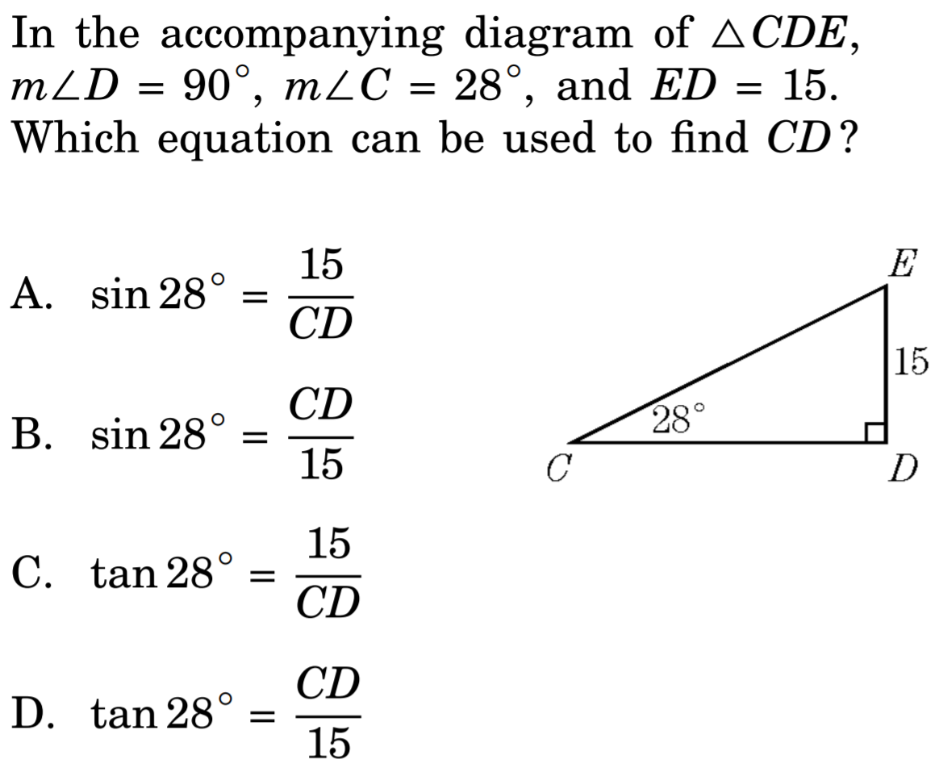

Slide 6
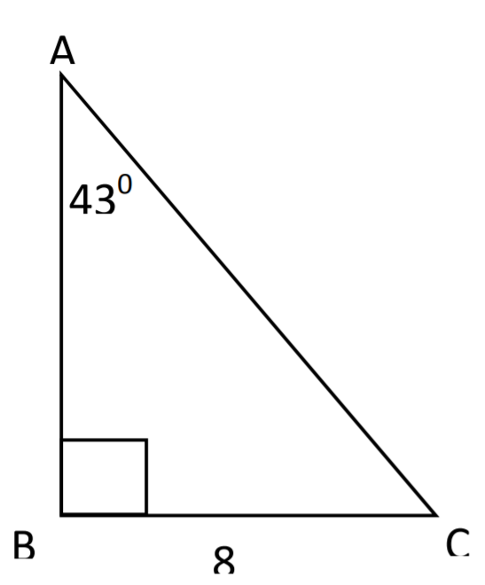
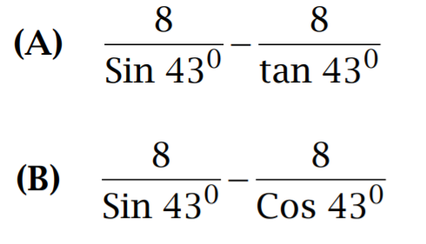
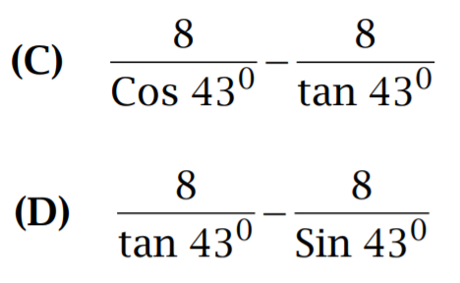

Slide 7

Given that $\tan{∅=\frac{12}{5}}. Find the lenth of "x"$
$$∅$$
x
24
a) 10 b) 12 c) 20 d) 26 e) $\sqrt{34}$

Slide 8
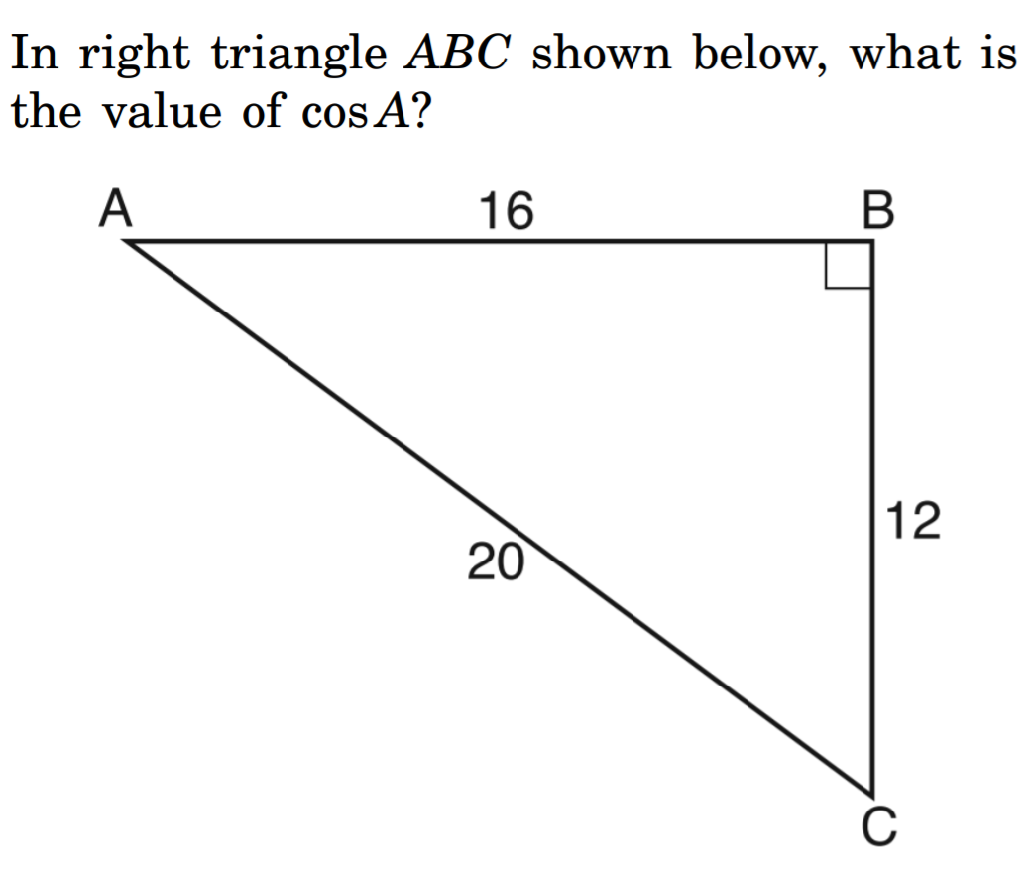
Cos A = 12 / 16
Cos A = 0.8
Cos A = 3/5
Cos A = 20 / 16
Cos A = 12 / 20

Slide 9
In the diagram below, the length of BC is equal to 1. Which expression is equal to the length of CD?
B
1
C
E
D

Slide 10
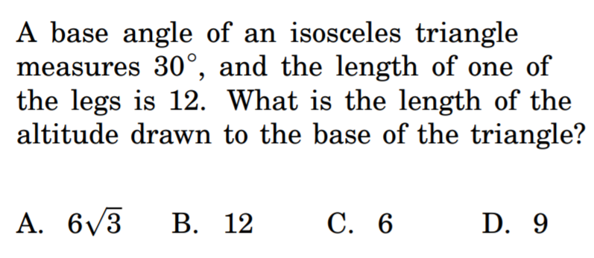

Slide 11
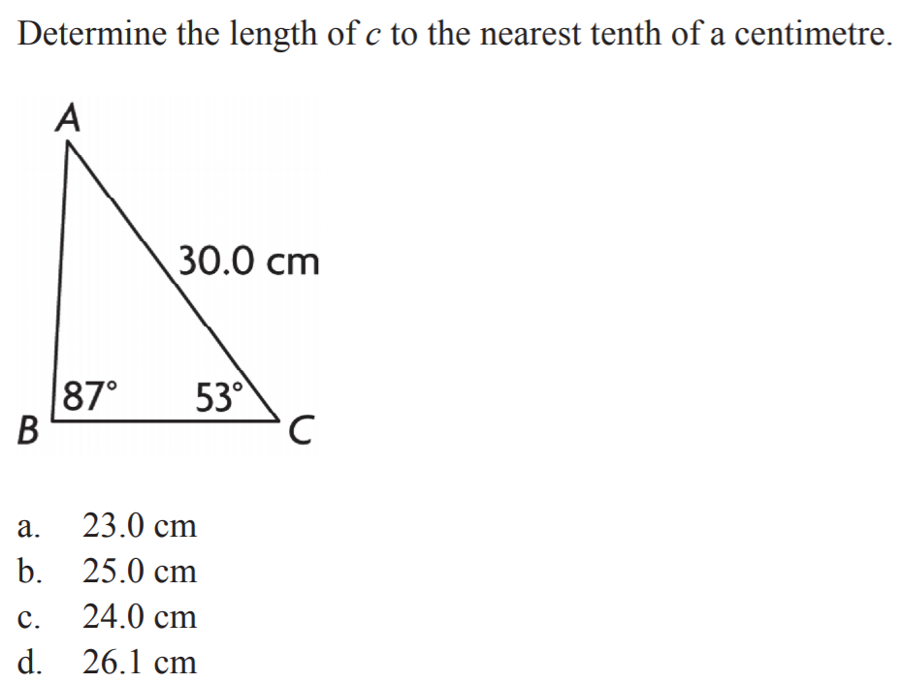

Slide 12
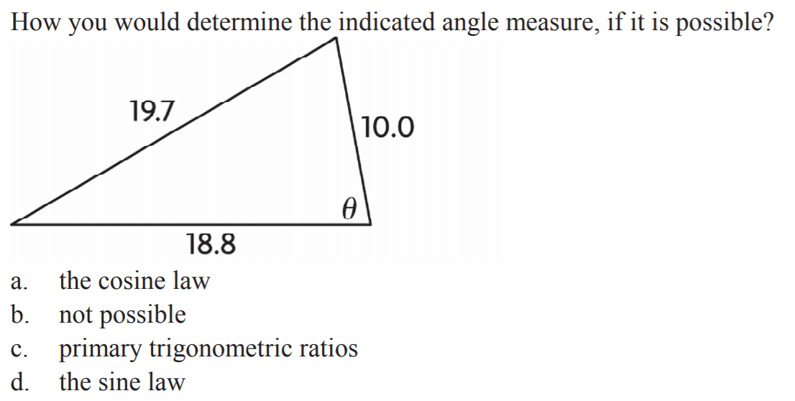

Slide 13
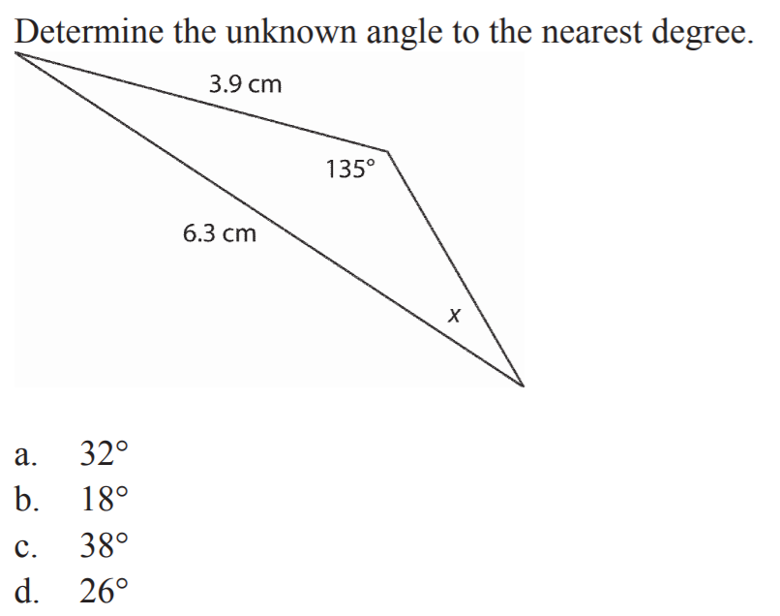

Slide 14
The diagram below is made of three right triangles. What is the length of “X”?

Slide 15
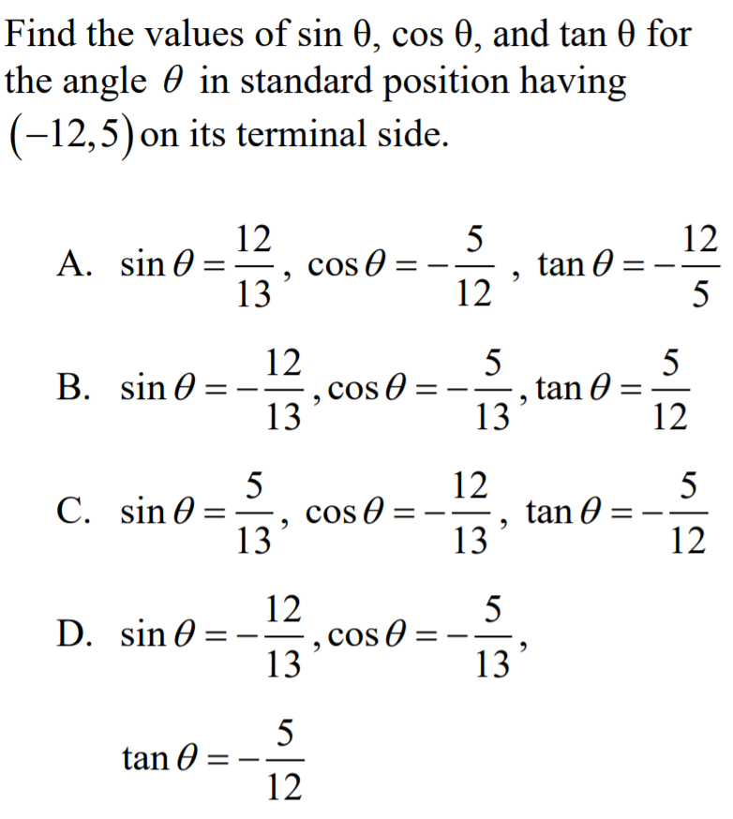

Slide 16
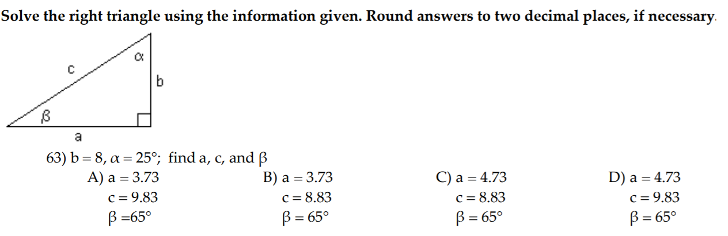

Slide 17
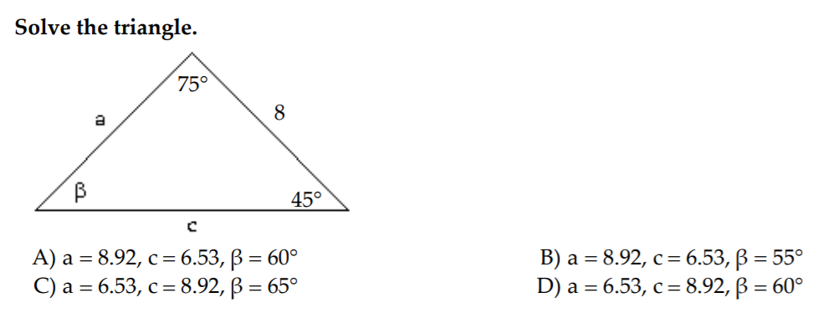

Slide 18
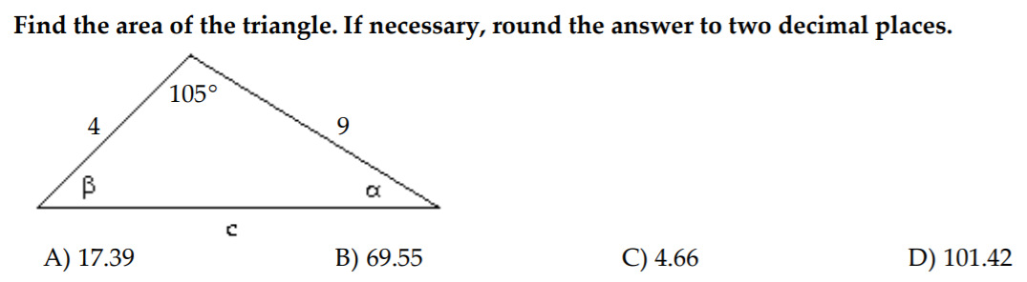

Slide 19
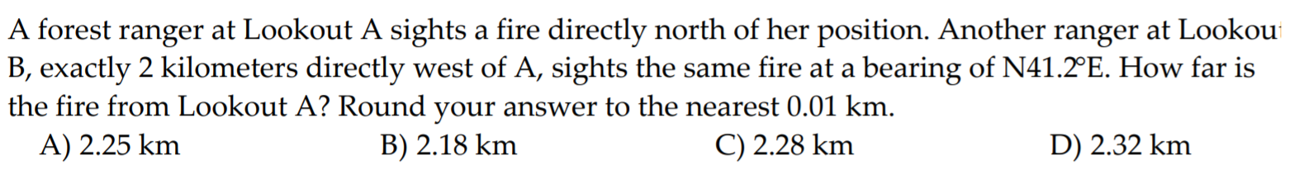

Slide 20
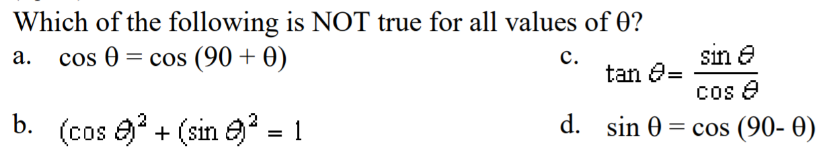

Slide 21
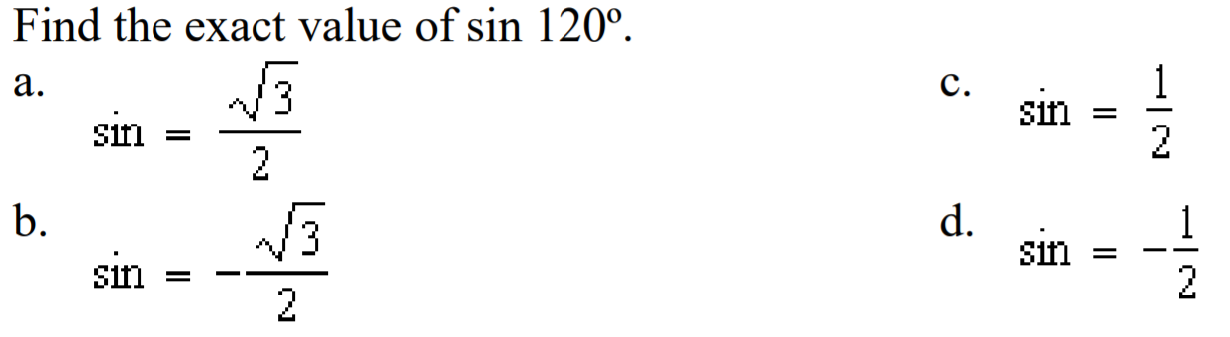

Slide 22
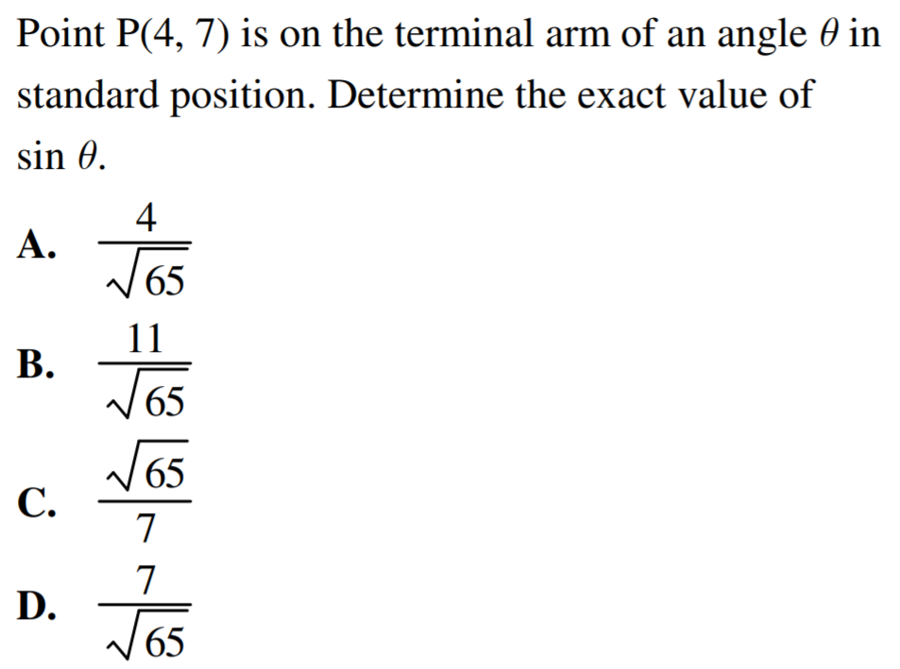

Slide 23
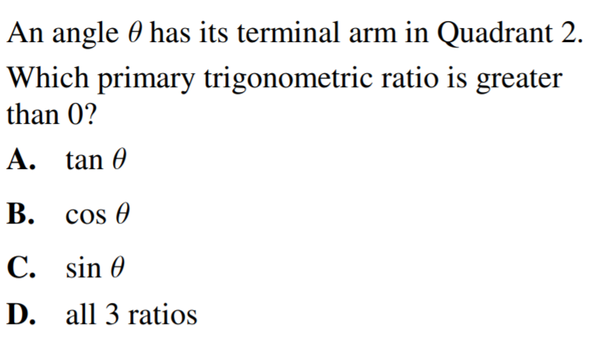

Slide 24
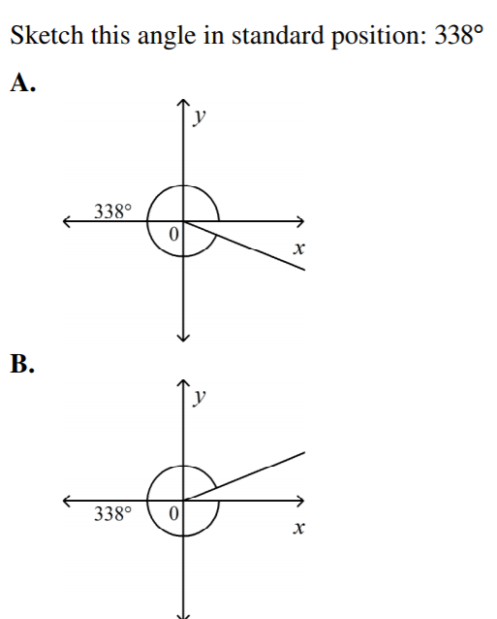
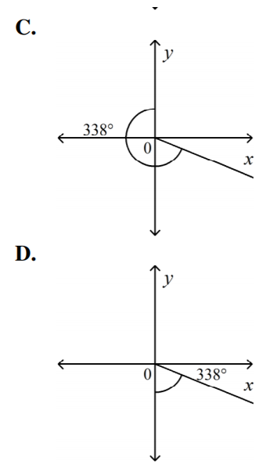

Slide 25
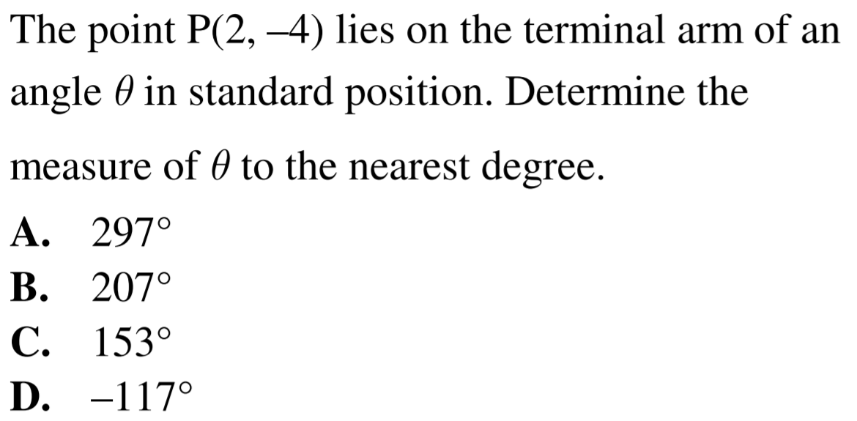

Slide 26
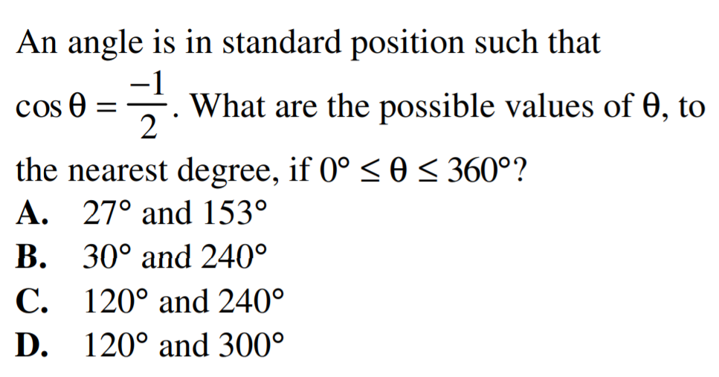

Slide 27
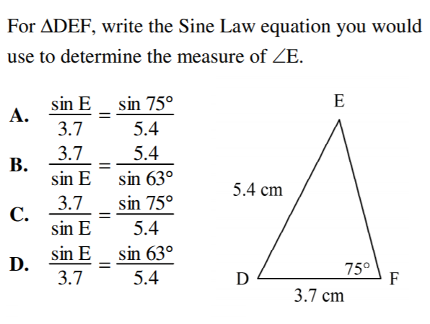

Slide 28
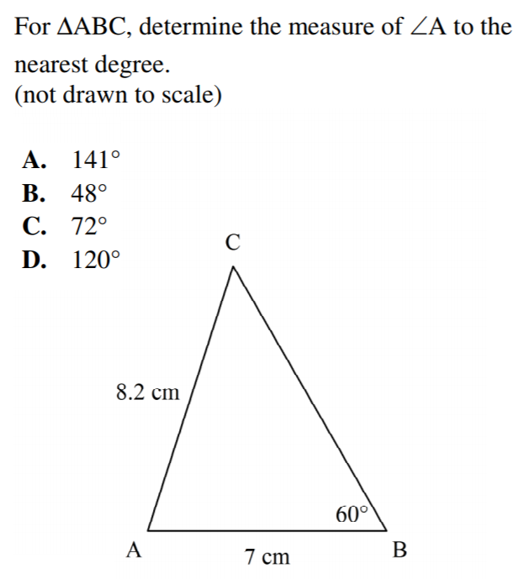

Slide 29
If angles “A” and “B” are supplementary, then which of the following statements are correct?

Slide 30
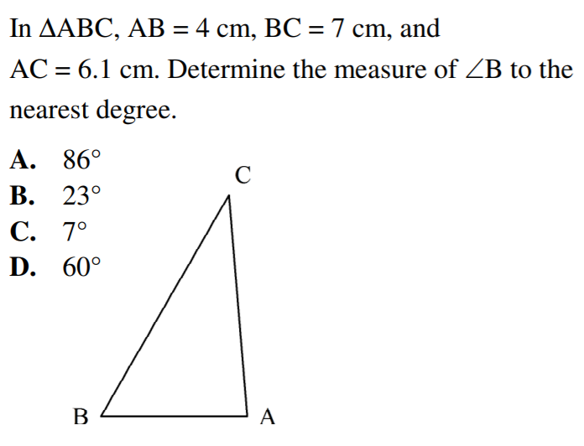

Slide 31
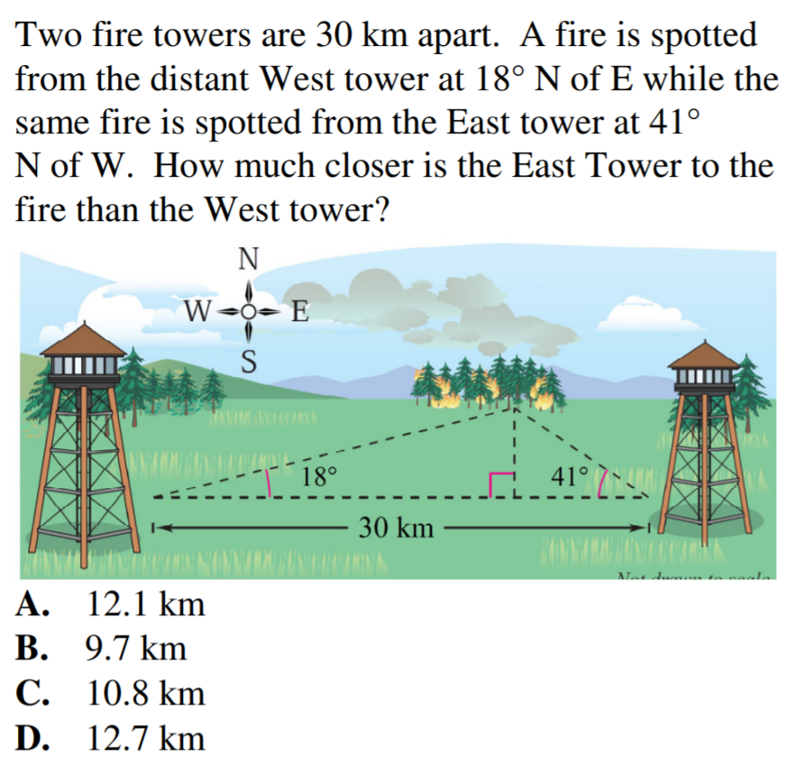

Slide 32
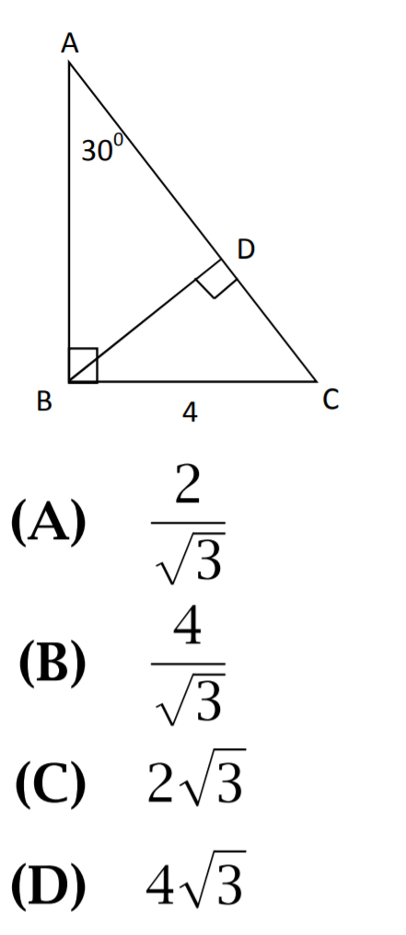

Slide 33
Which expression below is equal to the length of “m”?

Slide 34
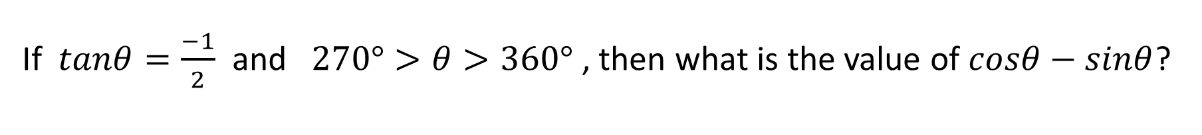
If $tanθ=\frac{−1}{2}$ and $270°>θ>360°$ , then what is the value of $cosθ−sinθ$?

Slide 35
What is the length of AB?
A
B
C
D

